Slide 1
HEALTHeLINK Compliance Training
What you SHOULD and SHOULD NOT do as a user.

Slide 2
It is very important to understand your role as a HEALTHeLINK user. Because we have a Participant Agreement and a Business Associate Agreement with your practice/organization, we are granting you HEALTHeLINK access to view medical records for the sole purpose of being able to provide more efficient and effective care and treatment to patients. As a HEALTHeLINK user, you have the responsibility to understand that you are ONLY allowed to look up patients that your practice/organization has a treating relationship with. You CAN NOT under any circumstance look up yourselves, friends, family members, co-workers, associates, or celebrities unless there is an explicit valid purpose of use to do so (i.e., Treatment). It is a DIRECT VIOLATION OF HIPAA and HEALTHeLINK’s policies and procedures. Otherwise, HEALTHeLINK will find the issue and bring it to your Privacy Officer for review. Consequences are to be determined by the practice/organization that you work for but could be escalated to the Office of Civil Rights and could expose you and your employer to litigation. You will also be at risk of being added to HEALTHeLINK’s exclusion list, meaning YOUR account will be permanently blocked.

Slide 3
IT IS PROHIBITED TO SHARE PASSWORDS WITH OTHER USERS TO LOG INTO HEALTHELINK. PLEASE DO NOT USE SOMEONE ELSE’S PASSWORD, OR SOMEONE WHO IS NO LONGER WITH YOUR ORGANIZATION. If you do not have an account, please contact the Authorized Contact for your practice to submit a request on your behalf. If you forgot your password, please contact the Helpdesk at 877-895-4724 or 716-842-6343 or email support@wnyhealthelink.com for further assistance.

Slide 4
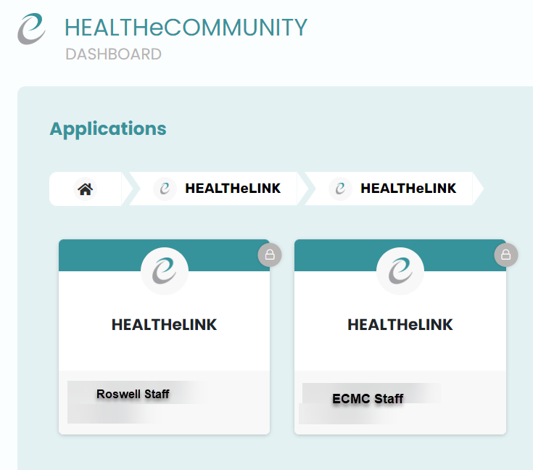
Multiple Health e Link badges
If you work at multiple organizations (Catholic Health, ECMC, Kaleida Health, Roswell Park, UBMD, etc.), you will have multiple badges to access HEALTHeLINK. You must access HEALTHeLINK through the proper badge in which you are working at the time of access. Your access is based upon patient consent and a direct treating relationship.

Slide 5
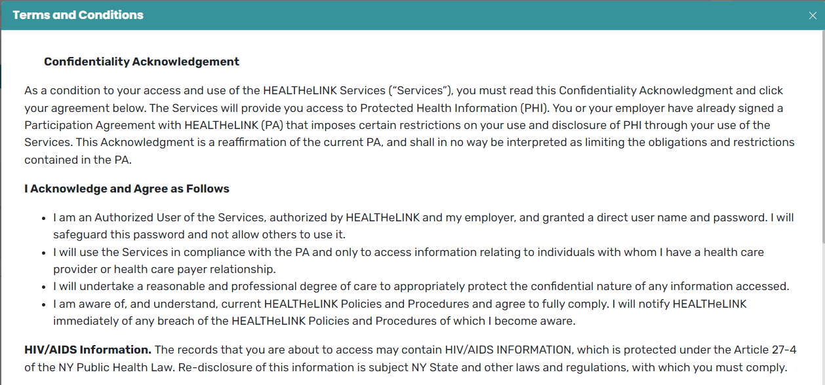
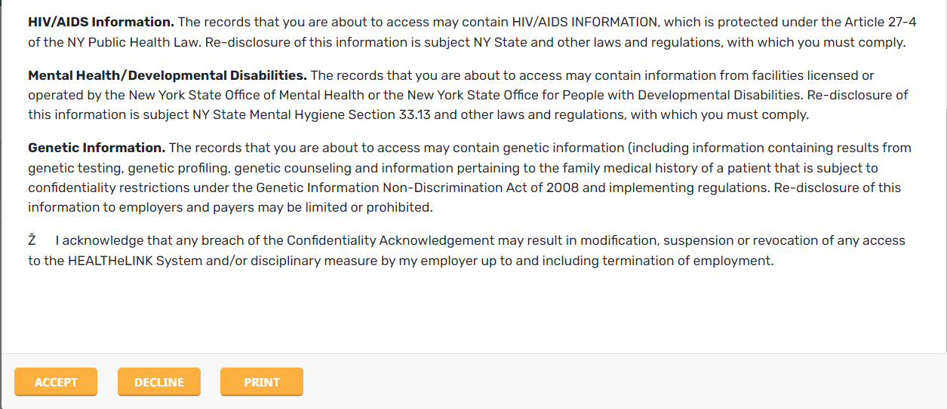
Health e Link Attestation
When you log into HEALTHeLINK, you will see this Confidentiality Acknowledgement pop up. You are REQUIRED to READ THROUGH this acknowledgement and understand the importance of accessing HEALTHeLINK. This acknowledgement serves as an agreement between you and HEALTHeLINK that you will comply and agree to the terms and conditions of using HEALTHeLINK. Once you read the acknowledgement, please click the “Accept” button to proceed.

Slide 6
HIPAA Violation Case Study UCLA Medical Center - 13 Firings & 6 Suspensions for Illegally Viewing Britney Spears’ Medical Records.
In early 2008, Britney Spears, the popular singer, was hospitalized at the UCLA Medical Center. During her hospitalization, her medical records were illegally accessed by the staff in the hospital. After an internal investigation, six doctors and thirteen employees were fired for snooping into Britney Spears’ medical records. Without a valid reason, none of the individuals involved were allowed to view her patient records. More than half of them weren’t authorized nor regarded as dedicated medical staff to view her PHI, which violates HIPAA rules.
Chin, K. (2023, September 8) Top 20 Worst HIPAA Violation Cases in History. https://www.upguard.com/blog/worst-hipaa-violation-cases

Slide 7
PLEASE REMEMBER!!! DO NOT LOOK UP YOURSELVES, CO-WORKERS, FRIENDS, FAMILY MEMBERS, ASSOCIATES, CELEBRITIES, ETC. YOU SHOULD ONLY BE ACCESSING PATIENTS THAT YOU HAVE A VALID PURPOSE OF USE, i.e., TREATMENT. EVERY TIME YOU LOG INTO HEALTHeLINK, IT IS LIKE A FINGERPRINT USED TO IDENTIFY WHAT YOU ARE DOING AND THE PATIENT RECORDS THAT YOU ARE ACCESSING. YOU ACKNOWLEDGE THAT ANY BREACH OF THE CONFIDENTIALITY ACKNOWLEDGEMENT MAY RESULT IN MODIFICATION, SUSPENSION OR REVOCATION OF ANY ACCESS TO THE HEALTHeLINK SYSTEM AND/OR DISCIPLINARY MEASURE BY YOUR EMPLOYER UP TO AND INCLUDING TERMINATION OF EMPLOYMENT.

Slide 8
Ask yourself… Is it worth it? Most Participants in WNY utilize HEALTHeLINK. If you misuse our system, you may be unable to use our systems in a future job.

Slide 9
Questions?

Slide 10
Health e Link Social Media Info

